Slide 1
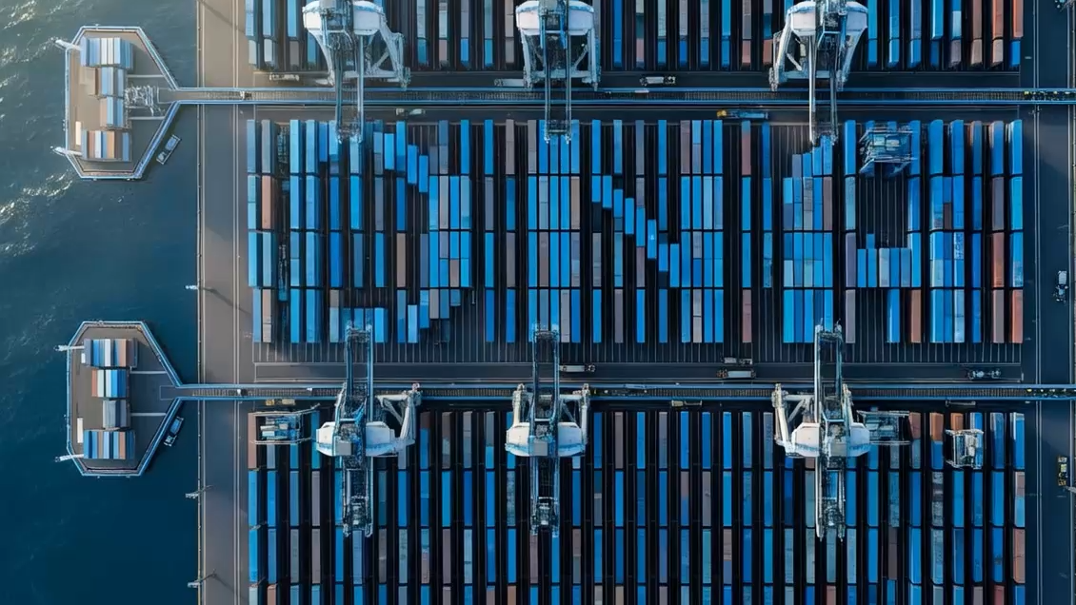
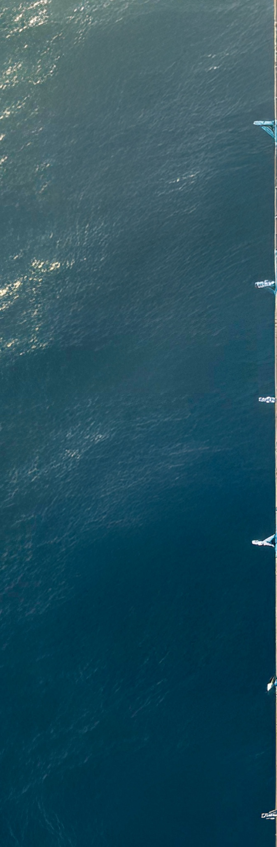

DNA WITH DIVERSITY
Sales Deck
MARCH 2026

Slide 2

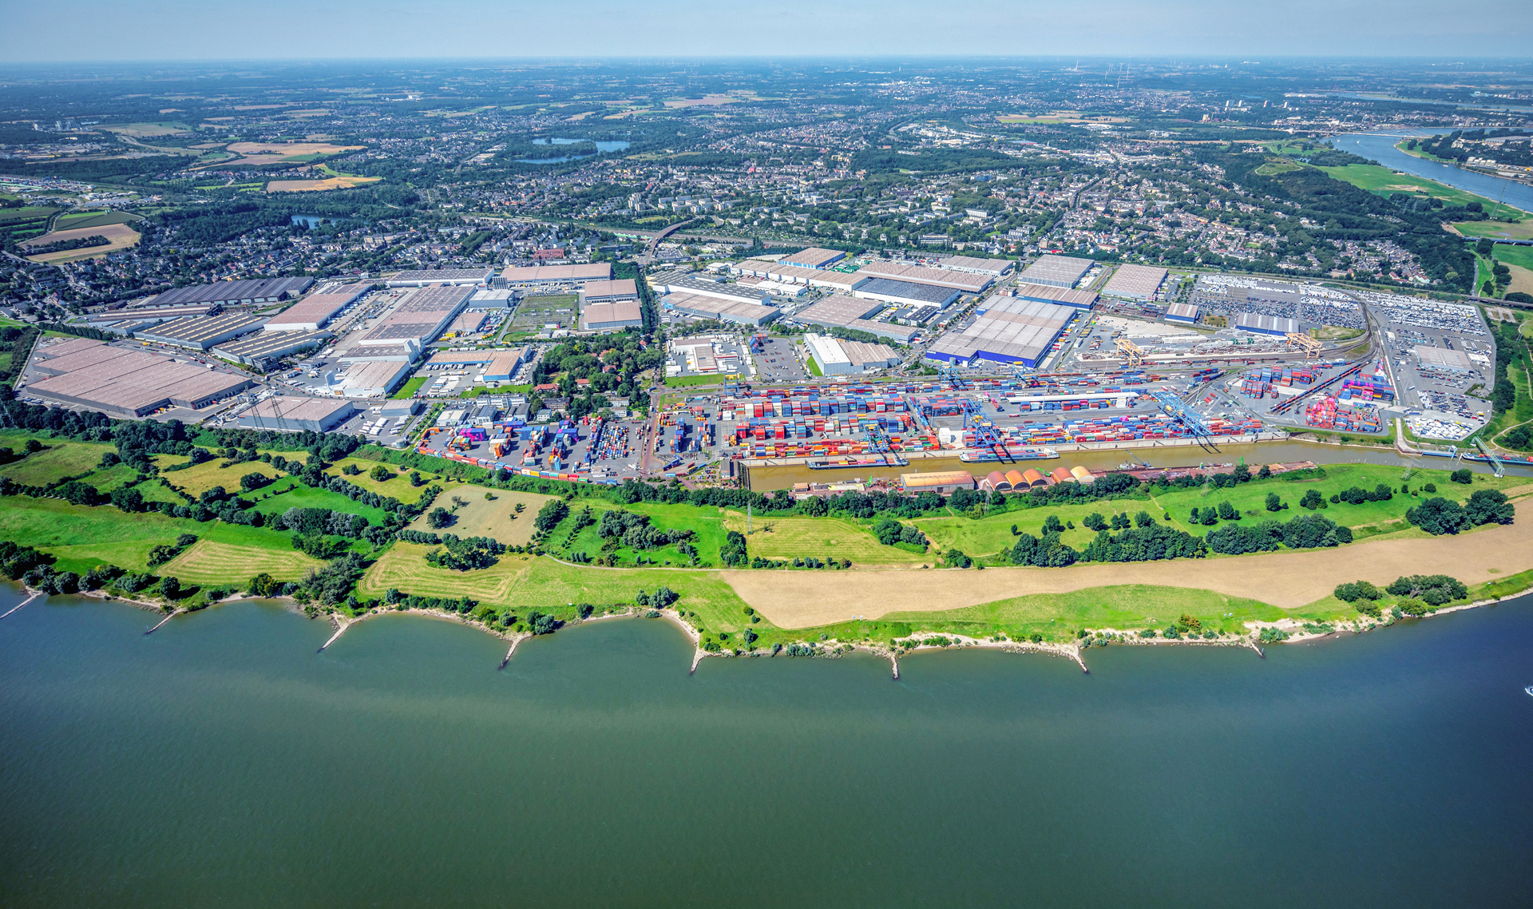
THE WORLD'S LARGEST INLAND PORT
Diversity is part of our DNA. That is why we are one of the most important logistics hubs in Europe.
    20.000 ships processed
    25.000
    trains processed
    100 mio. t
    of cargo handled
    4 Mio.
    TEU
    handled
    21
    harbor
    basin
    10
    container terminals
    200 km
    of private tracks
    ~300
    transportation and logistics companies
130 crane systems
1.600 hectares of land
52.000 workplaces
1.400 employees
Notes:
As the world’s largest inland port, Duisport is shaping the future of logistics—intelligently, connected, and sustainably. With state-of-the-art infrastructure and smart solutions, we connect economic regions, people, and markets. Duisport is more than just a port.

Slide 3
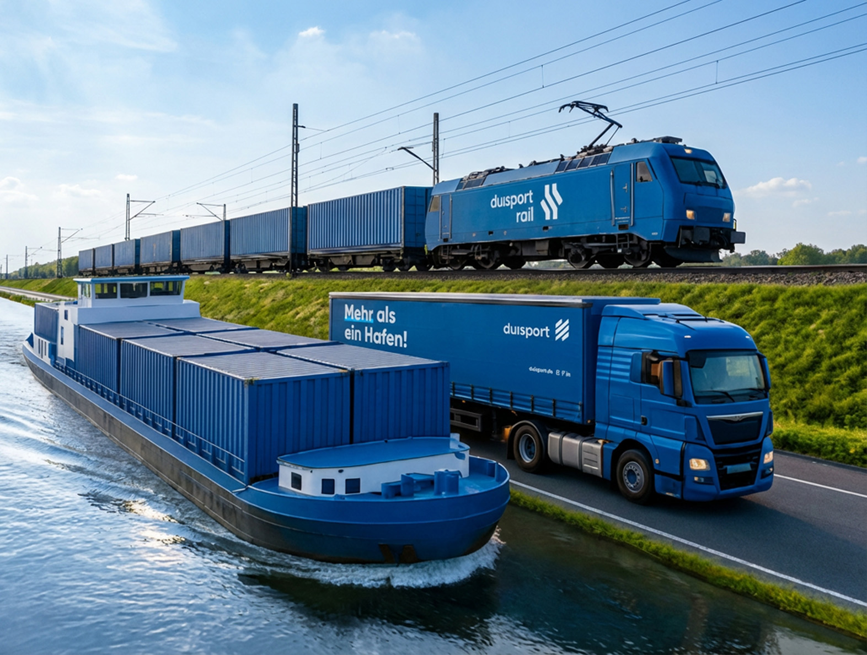
Europe's trimodal logistics
hub
Ideally located with
an international network
    International terminal investments
    Global locations
    in Belgium, the Netherlands, Poland, Turkey, India, and China
    400
    intermodal connections to
    100
    destinations

Slide 4
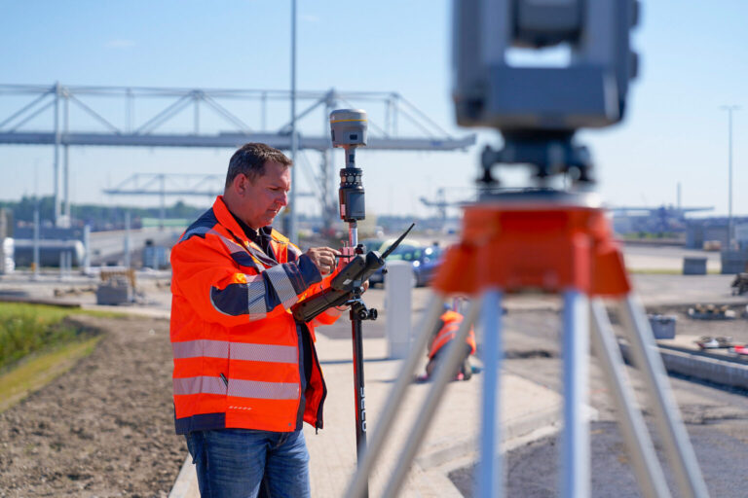
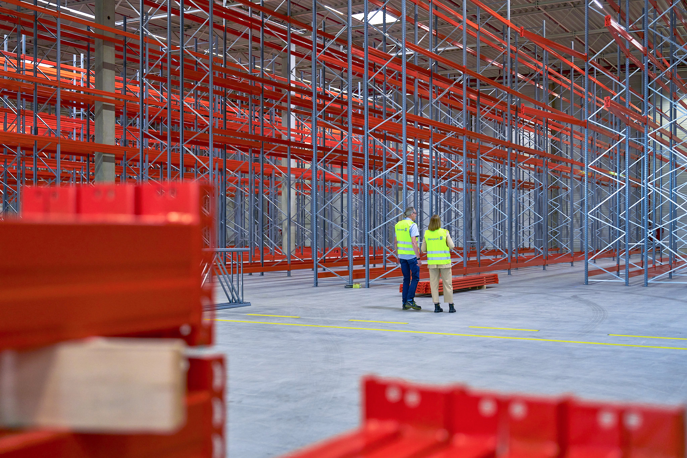
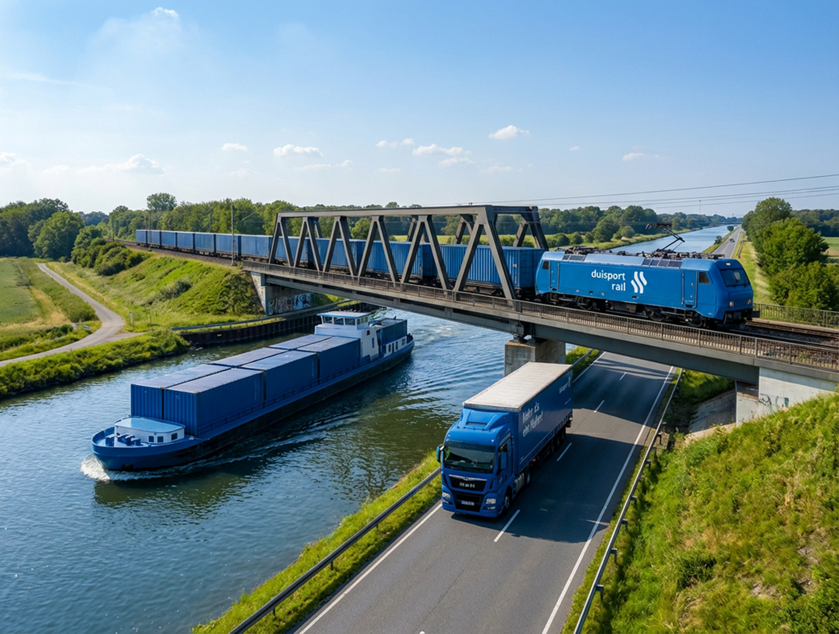
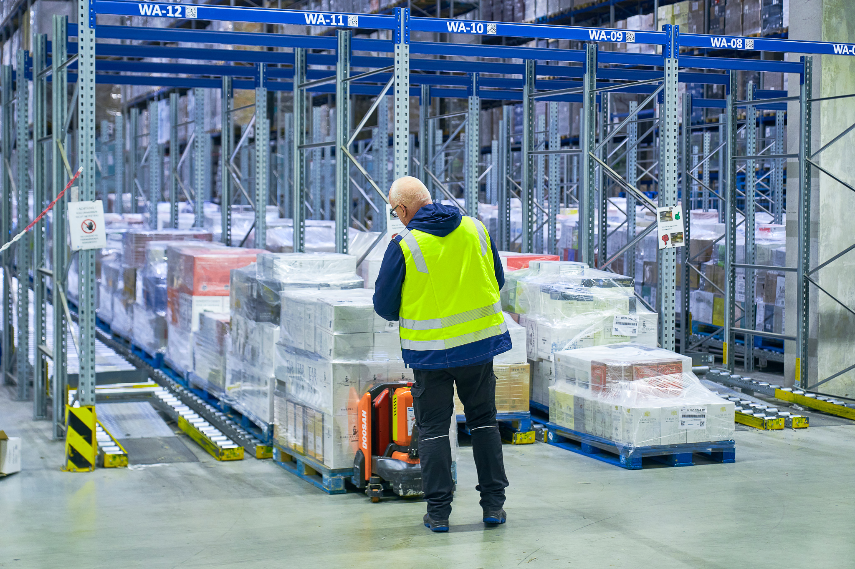
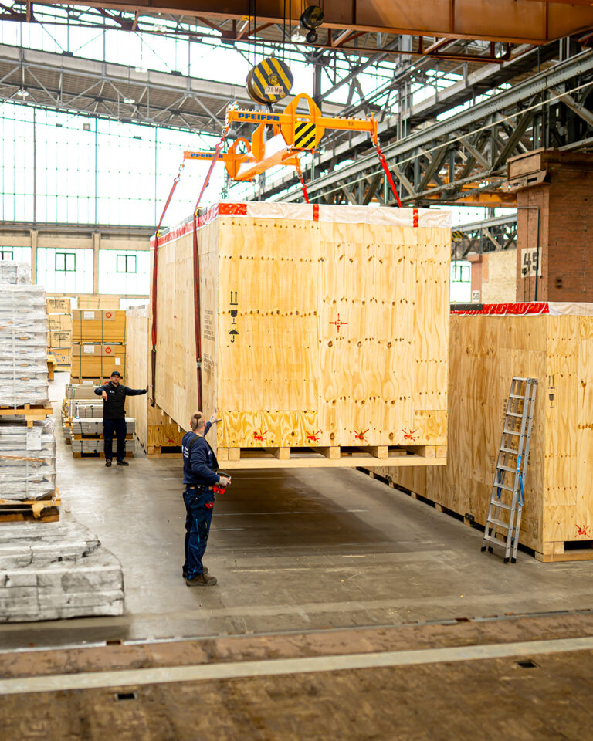
    THE DIVERSITY OF OUR PORTFOLIO
    That is what makes our
    entire port system so effective — from start to finish
    Real estate
    & land
    management
    Warehousing & logistics
    Industrial logistics
    Infrastructure
    Transport

Slide 5
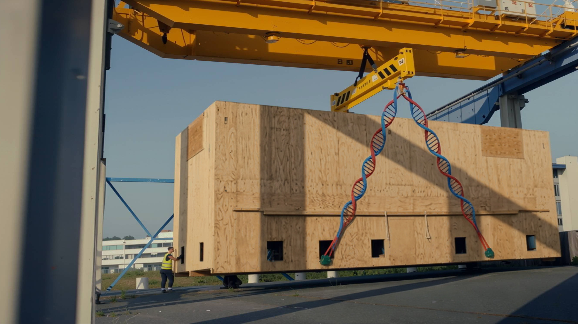

    Perfectly coded
    INDUSTRIAL SOLUTIONS
    for efficient logistics

Slide 6
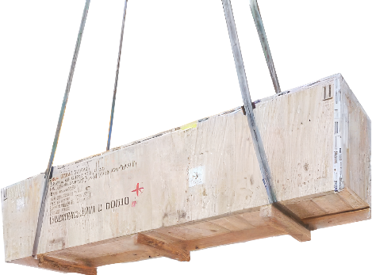
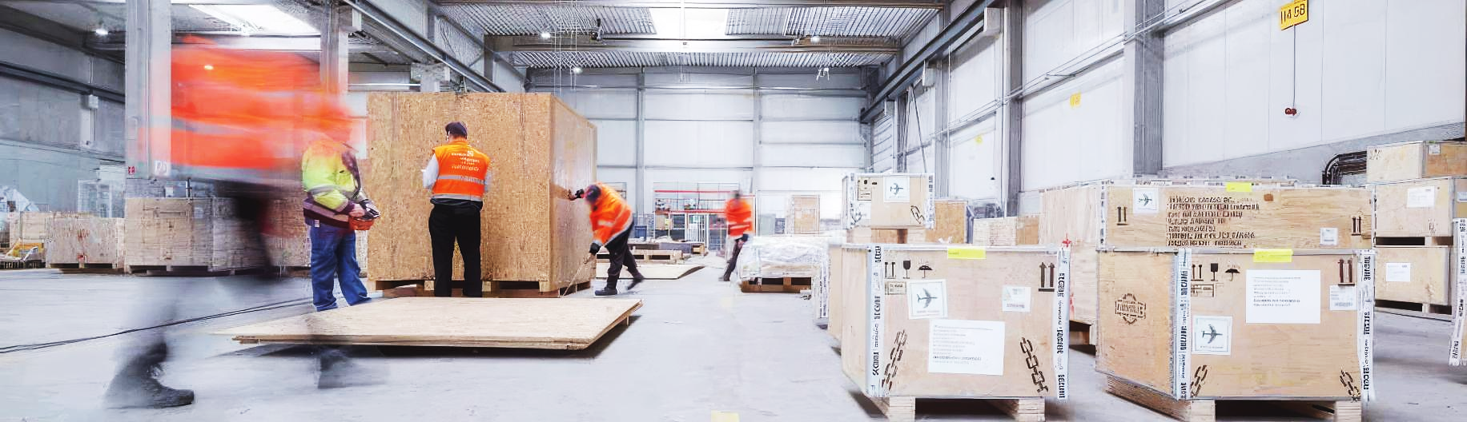
    We translate complex requirements into
    EFFICIENT SERVICES FROM A SINGLE SOURCE
Reliable. High-quality. Sustainable.
    Packaging systems and packaging materials production
    Plant logistics and Value-Added Services
    Industrial packaging
    Freight Forwarding and Lead Logistics Provider (LLP)

Slide 7
With resilience and flexibility
Single Point of Contact
    Fragmented
    supply chain
    One-Stop-Shop
    We handle the entire supply chain. Managing delivery
    schedules, arranging transportation, packaging,
    and delivery to the construction site—it’s all part of our daily routine.
    Unclear
    cost structure
    Cost transparency
    We are a lead logistics provider offering 100% cost transparency, starting right from the analysis phase of
    project planning.
    OUR SOLUTIONS
    Administrative overhead
    and resource allocation
    Resource efficiency
    We assume the risk associated with fluctuating workload
    and provide all necessary functionalities on a performance-based basis.
    YOUR CHALLENGES
    Global compliance risks
    Compliance
    We offer local expertise and global reach. Not only in packaging, but also in shipping regulations, document management, and customs regulations.
Notes:
INPUT
Challenges Faced by Potential Customers
Fragmented supply chain (multiple touchpoints lead to inefficiencies in the supply chain and, in the event of damage, make it difficult to clearly identify the party responsible)
Unclear cost structure: Costs for packaging, handling, and freight are often not transparent and difficult to budget for
High administrative burden and general allocation of resources

Slide 8




AS UNIQUE AS YOUR FINGERPRINT
Innovative packaging systems and packaging materials production
Focus on sustainability
Solar energy
for manufacturing
    Recycling of
    wood scraps
    Packaging systems designed to last for decades (clip box)
    Packaging consulting
    Packaging engineers provide consulting, plan, and handle complex requirements
    Global standards
    in accordance with ISPM 15 and additional require-ments, 100% FSC-certified
    Semi-automated manufacturing
    Digital, fast, and transparent processes
    Batch tracking
    Traceability of the wood used through the use of IT systems
    Tested.
    Certified.
    Audited.
    Packaging systems
    Reusable and tailored to the material, shipping method, and requirements
Internationally at more than 10 locations
Manufacturing versatility
Plywood | Screen printing plates | OSB | Multiplex | Glulam |
Solid wood | Composite packaging
Notes:
INPUT:
More than 10 production sites—including international locations
Plywood, OSB, screen printing plates, multiplex, glulam, solid wood, or even composite packaging made of wood and steel
For complex requirements, our packaging engineers provide consultation, planning, and implementation
Semi-automated manufacturing
Batch tracking of the wood used via IT systems
Heat-treated according to ISPM15 or kiln-dried, 100% PEFC-certifiedMost of the energy for production is generated by solar power
Wood waste is recycled

Slide 9
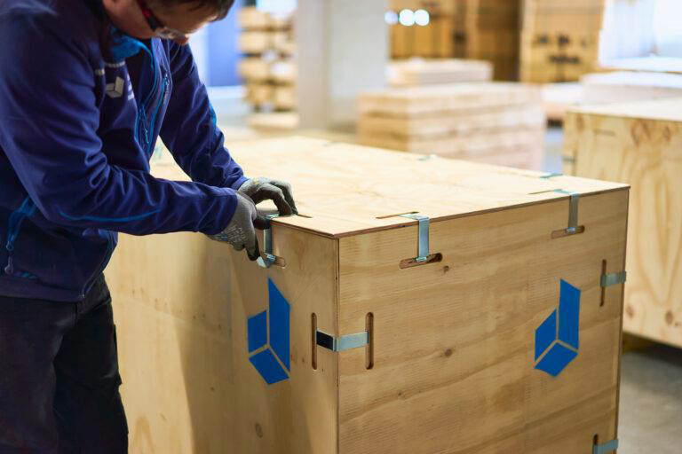
Protecting Assets – Throughout the Supply Chain
Industrial packaging
    High-quality packaging
    Industrial goods packaging in accordance with the world’s leading HPE packaging standard or accord-ing to individual specifications
    We're there when we're needed
    Deployment of mobile packaging teams, either on-site at the production facility or
    at our consolidation centers, as needed
    Preserved in optimal condition
    Preservation using all standard methods and for the necessary duration of storage and transport
    No screw is too small,
    no machine too big
    Whether it's a cardboard box,
    a sled, the floor, a shed, a crate,
    or a steel structure
    Experts in preserving value
    Trained, qualified, and
    audited staff
    Our own intensive training program for packaging professionals
    Mobile and flexible
    Safe under all circumstances
    Load securing
    Air freight
    Container congestion
    Hazardous materials
    Heavy-lift cargo handling
    Everything under control
    Transparent, digital process
    Photo documentation of all relevant processes in the customer portal
    (24/7 access)
Notes:
INPUT:
Mobile teams operate as needed
Teams permanently stationed at our customers’ production sites
Teams at our consolidation sites
Always in accordance with HPE guidelines or carried out in accordance with the regulations of our customers or their customers
Whether cardboard, skids, pallets, crates, boxes, or steel structures—no part is too small and no machine too large
Preservation using all standard market methods and standard durations
Digital process
Trained staff, high quality, audited
Documentation via photos of all relevant processes; photos stored in the customer portal (24/7 access for our customers)
Packaging professionals—we train our own staff
Air freight-safe, hazardous materials, container stowage; load securing
Warehousing
Heavy-lift handling
Storage

Slide 10
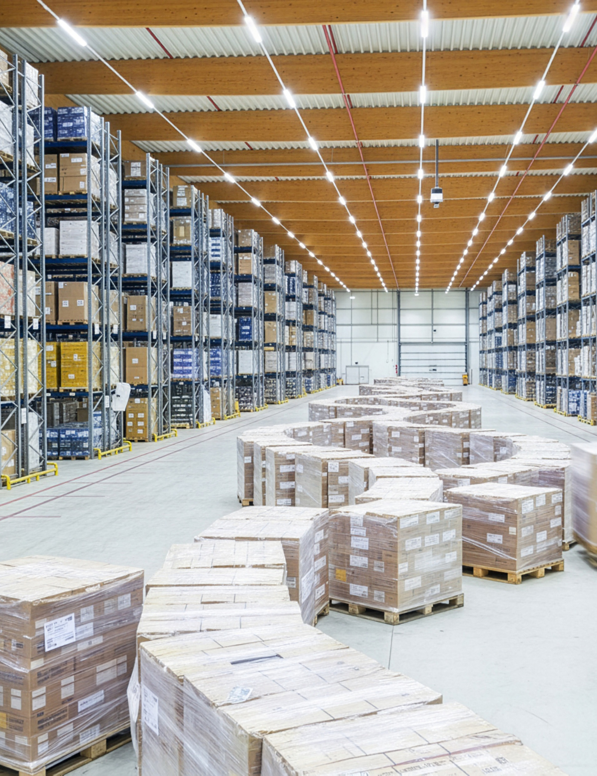
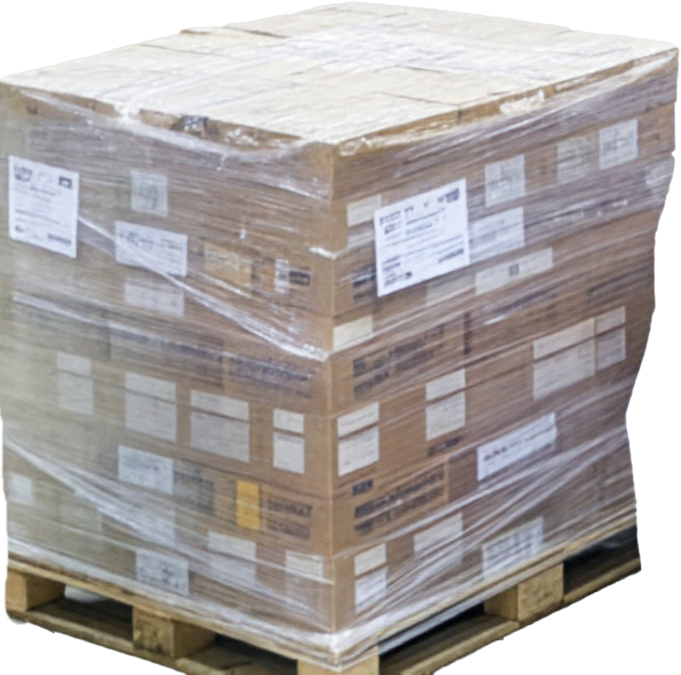
THE ADDED VALUE FOR THE CUSTOMER'S BUSINESS
With factory logistic and value added services
    Warehouse logistics
    Receiving department
    Completeness check in the goods receiving process
    Management of the warehouse,
    including all booking procedures
    Simple material processing, such as
    sawing or deburring
    Locations
    > 10
    Employees
    > 200
    Packages per year
    > 40.000
    Internal transport
    Supply and waste management
    for production
    Material handling in the factory
    Traded loose parts
    > 5 Mio.
Shipping logistics
    Handling of commercial shipping processes
    Operational shipping processing
    Load securing and much more
    We take responsibility
    for your goods – flexibly and efficiently
Notes:
INPUT:
Receiving vehicles
Unloading vehicles
Inspecting received goods according to specifications
Labeling, e.g., batch marking
Posting transactions in our own or the customer’s ERP system
Internal transport and handling, including the use of cranes, forklifts, or reach stackers
Simple material processing, such as sawing pipes or washing materials
Performing commercial shipping tasks
Packaging (see above)
Loading
Load securing

Slide 11
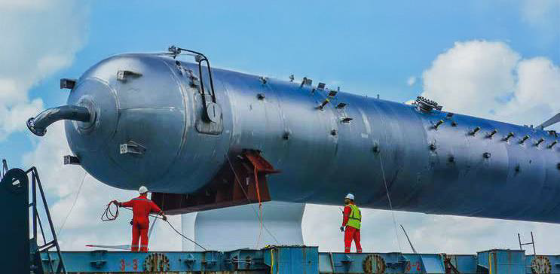
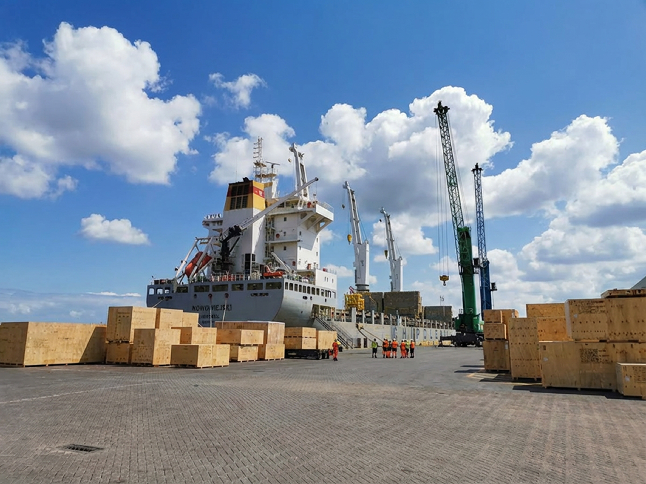
THE RIGHT WAY
Freight forwarding and Lead Logistics Provider
is the one that ensures your goods are delivered safely and efficiently from door to door.
    Freight forwarding & Lead Logistics Provider
    Significant relief, high transparency, and maximum flexibility
Your benefits
    Freight forwarding OR Lead Logistics Provider?
    This can also
    be done independently.
    All modes of transport
    (trucks, trains, ships, airplanes)
    Complete commercial and administrative handling of shipping
    Access to approximately 100 trucks from a sister company,
    if needed
    Smoothing out fluctuations
    in demand
    Reporting
    Customs: Certificates of
    origin, customs clearance,
    customs processing, preferential documents
    Hazardous materials handling
    for all modes of transport
    Reduced workload through minimization of interfaces
    Maximum compliance and security in global shipping
    The perfect balance of price, transit time, and service
    Transparency of costs
    at all times

Slide 12

End-to-End-Project logistics on schedule
Our case study:
Turnkey project management for three fertilizer plants in Egypt
    Solution
    Benefits
    Time and cost optimization through structured processes and tenders
    No construction delays
    High on-time delivery rate
    Significant reduction in
    the workload for the client organization
    Maximum transparency
    and traceability throughout the entire supply chain
    Reducing project risks in customs, transportation, and documentation
EGY
Global
    Traceability of every single step in the logistics process through the use of the batch tracking system.
    More than 1,000 suppliers, with over 1 million different parts.
    Active supplier management, centralized status tracking,
    and digital recording of
    all necessary data.
    Complete customs, document-tation, and payment processing.
    Packaging management, temporary storage, and consolidation across up to 30,000 m² of warehouse
    space.
    Coordination of all modes of transportation
    Bringing suppliers
    to the consolidation point
    Ocean freight (containers & breakbulk)
    Air freight & hazardous goods
    Custom solution: Antonov Charter for large components
    Coordinating local freight forwarders in Egypt, in consultation
    with the client and the end customer, acting as the primary point of contact.

Slide 13









A strong legacy with Success genes
More than 50 years of experience in packaging logistics
    > 10
    Locations with in-house manufacturing
    > 20
    Locations in Europe and Asia
    > 30
    Customer locations
    > 600
    Employees
    > 100 Mio.
    Revenue

Slide 14
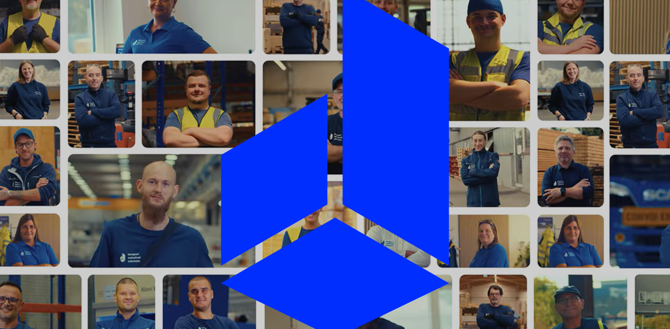
more than just industrial packaging
Personalized and holistic in every aspect

Slide 15

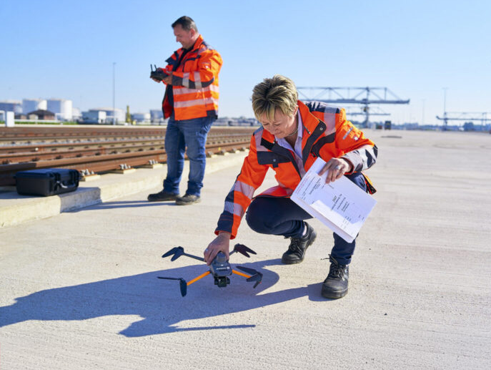

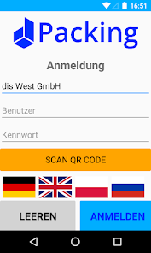

Smart packaging
Learn more about digitalization and innovation at duisport
in the double helix of structured data
duisport's digital strategy integrates advanced digital solutions into port and logistics processes
From artificial intelligence (AI) to real-time data monitoring and augmented reality (AR).
dis delivers clear benefits in terms of process efficiency and sustainability
Digital solutions—ranging from app-based material inspection
and 3D design planning to semi-automated production—help minimize waste and reduce costs, among other benefits.
Architecture & expertise
Digitization of business processes
Data & analysis
Digital business models
    Exemplary projects
    startport: The innovation platform for logistics solutions connects startups with logistics companies.
    RPIS: RiverPorts Planning and an information system for the digitization of inland waterway transport.
    TrailerPort: The BMVI-funded project is developing innovative solutions for the efficient integration of trailers into inland port operations.
Exemplary actions
Digital portals Customer portal with real-time information and supplier portal for more efficient communication
and secure documentation.
Apps
In-house developments that support internal processes. For more efficient and faster access to items such as photos, etc.
WMS
Use of the WMS by a sister company at three locations. Hand in hand.
duisport digital
dis digital
Notes:
INPUT:
Receiving vehicles
Unloading vehicles
Inspecting received goods according to specifications
Labeling, e.g., batch marking
Posting transactions in our own or the customer’s ERP system
Internal transport and handling, including the use of cranes, forklifts, or reach stackers
Simple material processing, such as sawing pipes or washing materials
Performing commercial shipping tasks
Packaging (see above)
Loading
Load securing

Slide 16
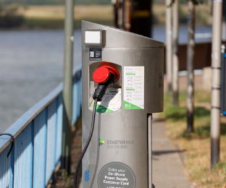






Responsibility and Diversity
Sustainability as a driver of growth and competitiveness
Environmental
A catalyst and pioneer of the green transition.
Example shore power:
69 shore power charging points throughout
the port area help reduce local noise and pollutant emissions.
Our industrial logistics and packaging solutions make a significant contribution to environmental sustainability, from procurement and production through reuse to disposal.
Exemplary actions
Social
Well-trained and diverse teams drive innovation and ensure
our future viability.
Example Charta der Vielfalt:
A commitment to recognizing,
valuing, and incorporating diversity into
the workplace.
Use of solar power
Green electricity
for 90% of
locations
(by 2025)
100% certified wood (PEFC)
Almost exclusively electric forklifts
in the packaging sector
Governance
Value-based governance for sustainable decisions and
long-term trust.
Example culture and values development:
Definition of 8 core values as
part of the group-wide culture and
strategy initiative.
Digital solutions to improve efficiency and reduce waste
Reuse and cascading use
    Wooden pallets and transport packaging as carbon sinks
    Packaging systems can be reused indefinitely when used properly
    duisport sustainable
    duisport industrial solutions sustainable
Learn more
about sustainability at duisport

Slide 17








Our actions are guided by our values
Deeply rooted in our DNA
Employee-centered approach
We support and challenge one another
Sustainability
We take
responsibility
Innovation
We shape
the future
Diversity
We stand for
fairness and
diversity
Courage & responsibility
We move forward
with courage and determination
Performance
orientation
We achieve
great things
Commitment
We are your
reliable partner
Team spirit
We are an
unbeatable team

Slide 18
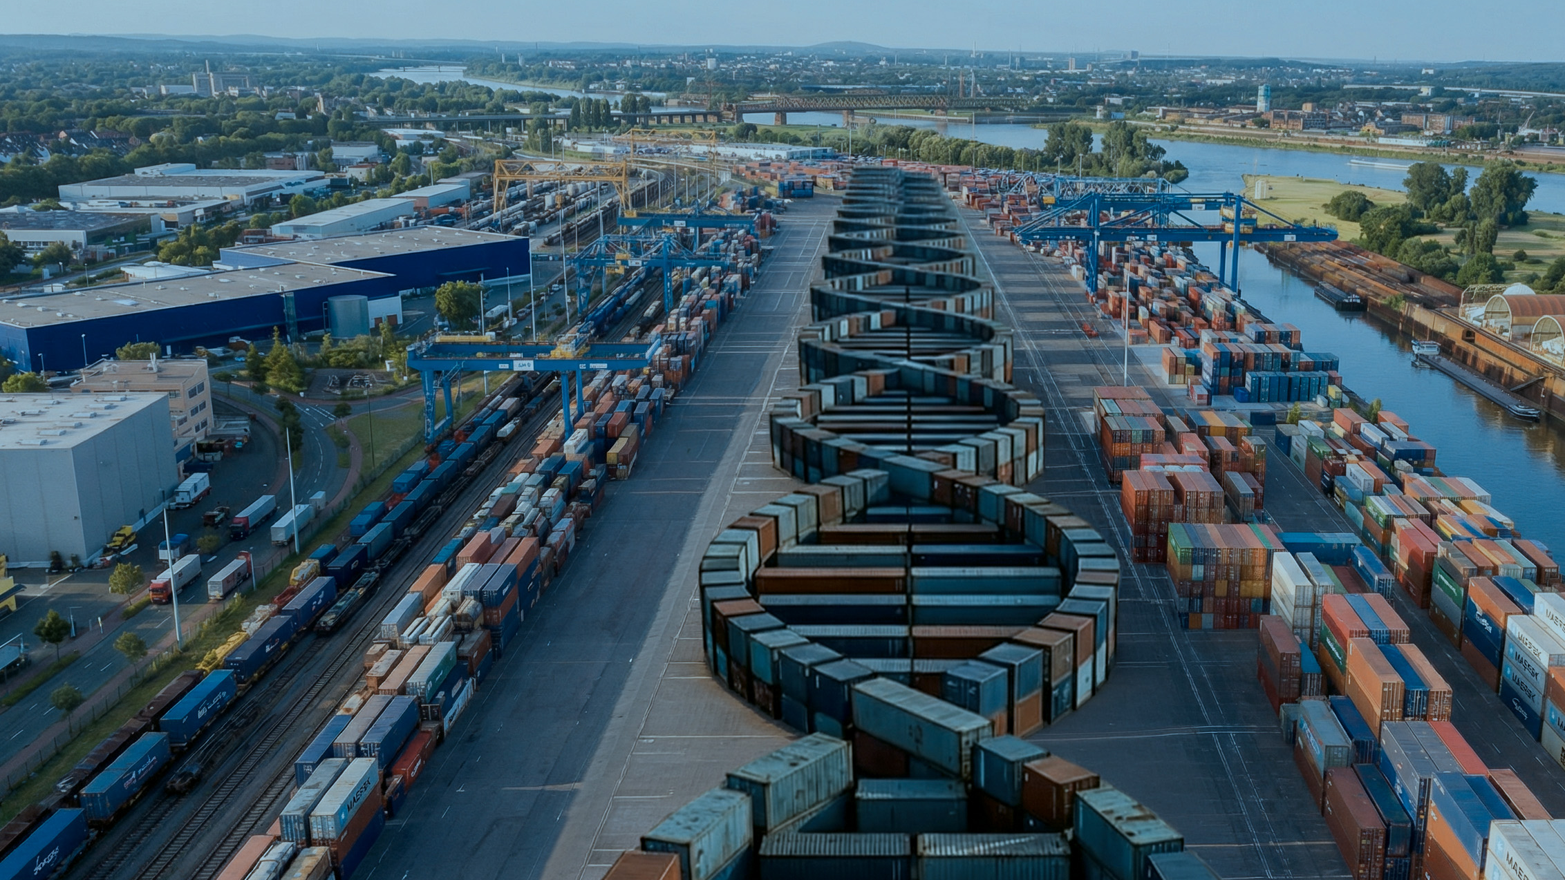
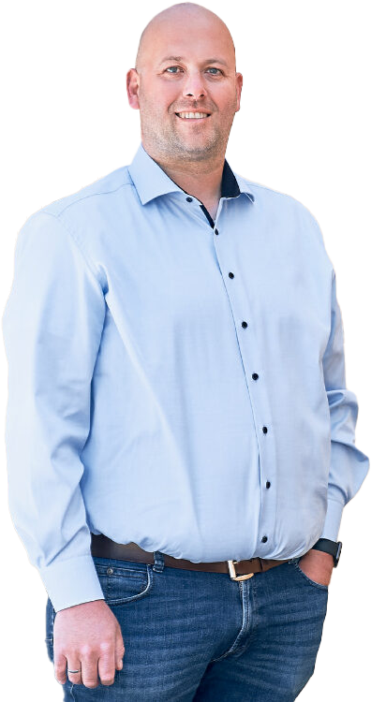
Working Together to reproduce SucCess
CONTACT
Daniel Herkel
Head of Sales and
Key Account Management
+49 203 803-2808
daniel.herkel@duisport.de

